Slide 1
WELCOME TO THE WORLD OF K8S

Slide 2
- K8S HANDSON -

Slide 3
K8S HANDSON DEPLOY AND EXPOSE
Create a new deployment with a name of your choice
Image to use: yanivomc/spring-music:latest
Once the service is deployed (verify)
Expose the deploy using type = LoadBalancer and with port 8090:8080
Once Exposed and verified scale your pods to 2
Next, Grab the LB CNAME record and check it in your browser.
Once completed please delete your deployment and service using: - kubectl delete services/[name of the service]
- kubectl delete deployment/[name of the deployment]

Slide 4
- 10 Antipatterns -
for Kubernetes Deployments

Slide 5
Putting the configuration file inside/alongside the Docker image.
Not using Helm or other kinds of templating.
Deploying things in a specific order. Applications shouldn’t crash because a dependency isn’t ready.
Deploying pods without set memory and/or CPU limits
Pulling the latest tag in containers in production
Deploying new updates/fixes by killing pods so they pull the new Docker images during the restart process
Mixing both production and non-production workloads in the same cluster.
Not using blue/green or canaries for mission critical deployments (the default rolling update of Kubernetes is not always enough)
Not having metrics in place to understand if a deployment was successful or not (your health checks need application support).
Cloud vendor lock-in: Locking yourself into an IaaS provider’s Kubernetes or serverless computing services.

Slide 6
- K8S VOLUMES -
MAKE PODS STORAGE PERSISTENT

Slide 7
K8S VOLUMES
Files in a container are ephemeral, which presents some problems for non-trivial applications when running in containers.
First, when a container crashes, kubelet will restart it, but the files will be lost - the container starts with a clean state.
Secondly when running containers together in a Pod it is often necessary to share files between those containers. The Kubernetes Volume abstraction solves both of these problems as seen below
NODE I
POD A
NODE II
POD B
DOCKER ENGINE
CONTAINER
A
CONTAINER
B
DOCKER ENGINE
CONTAINER
A
CONTAINER
B
SHARED VOLUME
SHARED VOLUME

Slide 8
- K8S NAMESPACES -

Slide 9
K8S NAMESPACES
Kubernetes supports multiple virtual clusters backed by the same physical cluster. These virtual clusters are called namespaces. Namespaces are intended for use in environments with many users and applications spread across multiple teams, projects or clients.
For clusters with a few to tens of users, you should not need to create or think about namespaces at all. Start using namespaces when you need the features they provide such as: divide cluster resources between multiple users / envs / regions / hw type’s

Slide 10
- K8S JOB -

Slide 11
K8S JOB
A job in Kubernetes is a supervisor for pods carrying out batch processes. that is, a process that runs for a certain time to completion, for example a calculation or a backup operation.

Slide 12
- K8S ROLLING DEPLOYMENTS -

Slide 13
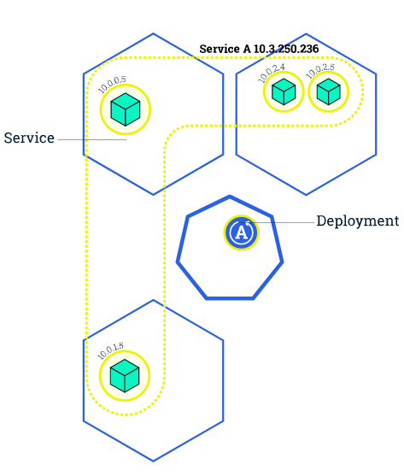
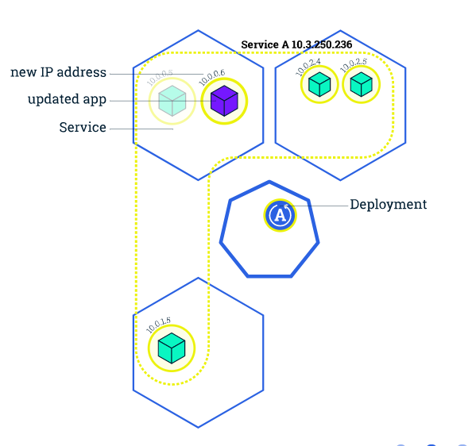
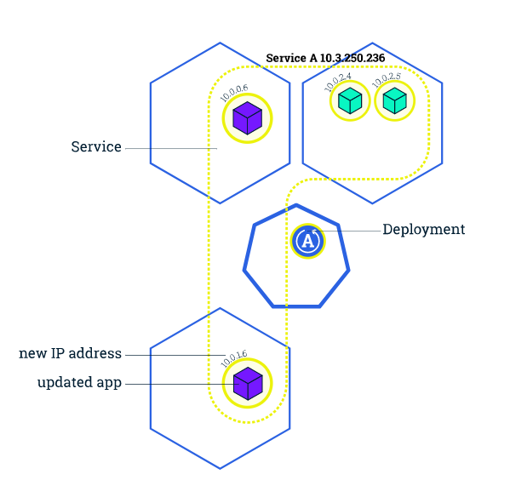
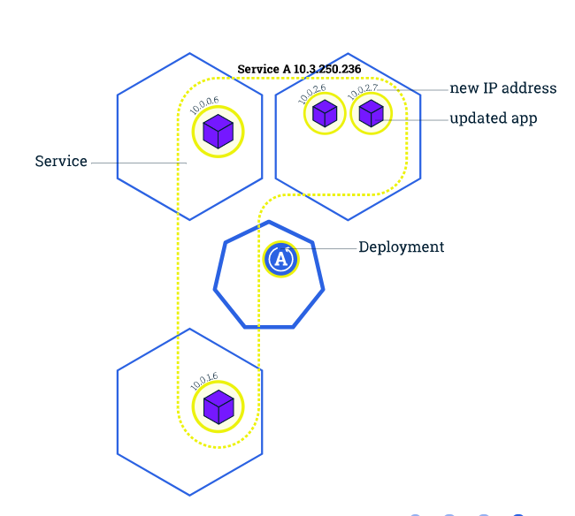
K8S ROLLING DEPLOYMENTS
Rolling updates allow Deployments' update to take place with zero downtime by incrementally updating Pods instances with new ones. The new Pods will be scheduled on Nodes with available resources. Same goes for Reverts !

Slide 14
K8S ROLLING DEPLOYMENTS
Rolling updates allow the following actions:
Promote an application from one environment to another (via container image updates)
Rollback to previous versions
Continuous Integration and Continuous Delivery of applications with zero downtime

Slide 15
K8S ROLLING DEPLOYMENTS
To update the image of our application from version X to version Y, we use the set image command followed by the deployment Name and the new image version
kubectl set image deployments/[name] [container name]=repo/image:version --record
The above command will notify the Deployment to use different image while the app start a rolling update.
VALIDATION
# Check the status of the new pods using
kubectl get pods
# Verify rollout completion
kubectl rollout status deployments/[name]
# Show history of rollout for specific deployment
kubectl rollout history deployments/[name]
# Rollback to latest working version:
kubectl rollout undo deployments/[name]
# Rollback to specific version:
kubectl rollout undo deployments/[name] --to-revision ?

Slide 16
- K8S HANDSON -

Slide 17
K8S HANDSON DEPLOY AND EXPOSE
In this Handson we will deploy an application with 3 pods, Once deployed we will release a new version of our application.
Delete all other services that you created ! and deployments that you have done
Deploy a new application with 3 pods (use --record!)
Image to use: supergiantkir/animals:bear
Expose the deploy using type = LoadBalancer and with port 80:80
Once Exposed and verified (check in browser that you see a BEAR!) -
Deploy the new version of our application using the image:
supergiantkir/animals:moose
Validate deploy and that you are seeing a Bear in your browser and than a moose.
Once completed rollback
Verify you now see a bear again
Delete your services and deployment

Slide 18
- K8S SPECS -
In K8S same as in Docker we can interact with the CLI to build and manage our objects but in real life we would like To Automate Manual tasks by using and building Object definitions in YAML - “Yet Another Markup Language”

Slide 19
Module Agenda: K8S SPECS
PODS
LABELS
REPLICASETS
SERVICES
DEPLOYMENTS

Slide 20
- K8S PODS SPECS -

Slide 21
K8S SPECS - POD
As learned - In K8S, a group of one or more containers is called a pod. Containers in a pod are deployed together, and are started, stopped, and replicated as a group
The following is an example of how we describe a pod of type NGINX using object definitions:
POD SPECS: create a file name pod-nginx.yaml and paste the below into it
apiVersion: v1 # K8S API Version
kind: Pod # Object Type
metadata:
name: nginx
spec:
containers: # NOTE THAT BELOW HERE WE CAN ADD AS MANY CONTAINERS WE WISH TO ENCAPSULATE IN THE SAME POD
- name: nginx
image: nginx:1.7.9
ports:
- containerPort: 80
- name: spring-music
image: spring-music:latest
ports:
- containerPort: 8080

Slide 22
- K8S HANDSON -

Slide 23
K8S HANDSON POD SPEC AND VOLUMES
In this Handson we will deploy an application with 1 pod but two containers,
Run the following spec file and fix it
POD SPECS: create a file name pod-nginx.yaml and paste the below into it
apiVersion: v1
kind: Pod
metadata:
name: nginx
spec:
containers:
- name: nginx
image: nginx:1.7.9
ports:
- containerPort: 80
- name: spring-music
image: spring-music:e22
ports:
- containerPort: 8080

Slide 24
K8S HANDSON POD SPEC AND VOLUMES
FIRST TIME WITH VIM?
WORKING WITH VIM: (case sensitive - EVERYTHING IN LOWERCASE)
vim filename.yaml
“:” set paste [enter]
“I” [enter]
When you wish to save [esc] >>>> “:”wq

Slide 25
K8S SPECS - POD
Important to understand and remember:
A pod definition is a declaration of a desired state. Desired state is a very important concept in the Kubernetes model.
Pod Management: Creating new pod base on our Yaml
# Create a configuration from a yaml file / Change configuration $ > kubectl apply -f /some/folder/pod-nginx.yaml
# Force replace configuration using a yaml file $ > kubectl replace --force -f /some/folder/pod-nginx.yaml
# Delete configuration using a yaml file $ > kubectl delete -f /some/folder/pod-nginx.yaml
# Pod Management: Than list our pods
$ > kubectl get pods
$ > kubectl describe pods [pod name]

Slide 26
- K8S PODS VOLUME -

Slide 27
K8S SPECS - VOLUME
Making our pods data persistent using volumes Same as in docker (but not really the same as docker can support only one Volume driver per container and K8S multiple drivers as described here) we use Volume to store persistent data cross containers which will outlive containers
# 1. We define the volume and driver type as followed
volumes:
- name: redis-persistent-storage # Volume name
emptyDir: {} # Volume type
# 2. We mount the volume within a container definition
volumeMounts:
- name: redis-persistent-storage # name must match the volume name defined in volumes
mountPath: /data/redis # mount path within the container

Slide 28
K8S PODS: Volumes Real life example
Creating a volume and mounting it to our previous pod-nginx.yaml will look like this ->
apiVersion: v1
kind: Pod
metadata:
name: redis
spec:
containers:
- name: nginx
image: nginx:1.7.9
volumeMounts:
- name: nginx-files
mountPath: /var/www/
- name: spring-music
image: yanivomc/spring-music:latest
volumeMounts:
- name: nginx-files
mountPath: /tmp/
ports:
- containerPort: 8080
volumes:
- name: nginx-files
emptyDir: {}
Volume Types
EmptyDir: Creates a new directory that will exist as long as the Pod is running on the node, but it can persist across container failures and restarts.
HostPath: Mounts an existing directory on the node’s file system
(e.g. /var/logs).
See volumes for more details.

Slide 29
- K8S HANDSON -

Slide 30
K8S HANDSON POD SPEC AND VOLUMES
In this Handson we will deploy an application with 1 pod but two containers, Both containers will share the same volume we create.
write a new spec with the following instructions
Create a pod with two containers
Container 1
name: app1 and image: supergiantkir/animals:bear
Container 2
name: app2 and image: yanivomc/spring-music:latest
Add a volume
type: hostpath , name: app-storage, mount /tmp/files
mount app-storage to both containers under “/storage” folder inside our containers
Deploy our pod

Slide 31
K8S HANDSON POD SPEC AND VOLUMES
Once you’ve deployed your POD:
Open a shell in each of the containers of your newly created pods
use: kubectl exec -ti [name of your pod] -c [name of your container in the pod] [command]
question: why do we need the -c ?
Once you are inside of your containers write a file in each of them under “/storage” and see that it’s now exists and shared between them.
Connect to you NODE (WORKER) using the same SSH command that you connected to the master BUT use the IP of the worker (HOW DO YOU GET IT? - TIP get nodes with -o wide)
Go to /tmp/files and see that the files exists in the WORKER NODE

Slide 32
- K8S LABELS -

Slide 33
K8S LABELS
By using labels we can organize Pods into groups.
The system for achieving this in K8S called Labels. Labels are key-value pairs that are attached to each object in Kubernetes. Label selectors can be passed along with a RESTful list request to the apiserver to retrieve a list of objects which match that label selector.
We define our Labels in a spec like so:
labels:
app: nginx

Slide 34
K8S LABELS
Here is our nginx-pod.yaml definition with Labels
apiVersion: v1
kind: Pod
metadata:
name: nginx
labels:
app: nginx
version: "1"
spec:
containers:
- name: nginx
image: nginx
ports:
- containerPort: 80

Slide 35
K8S LABELS
More motivations to use labels ?
"release" : "stable", "release" : "canary"
"environment" : "dev", "environment" : "qa", "environment" : "production"
"tier" : "frontend", "tier" : "backend", "tier" : "cache"
"partition" : "customerA", "partition" : "customerB"
"track" : "daily", "track" : "weekly"

Slide 36
K8S Labels selector - Playing around
Label selector is the core grouping primitive in Kubernetes so let’s give it a try
# Set your nodes with different labels as followed:
to label your nodes use the following command: kubectl label <resource>/<name> KEY=VALUE - Node1 - env=prod , tier=fe, app=nginx
- Node2 - env=prod , tier=be, app=haproxy
# 2. Once you tagged it run
kubectl get nodes -l env=prod,tier=fe
kubectl get nodes -l tier=fe
kubectl get nodes -l env=prod
kubectl get nodes -l app in (nginx, haproxy)’

Slide 37
K8S Labels selector - playground
Using the label we set to our node we can create a pod that will run only there usage scenario for label requirement is for Pods to specify node selection criteria.
For example, the sample Pod below selects nodes with the label “env=prod”.
apiVersion: v1
kind: Pod
metadata:
name: cuda-test
spec:
containers:
- name: cuda-test
image: "yanivomc/spring-music:latest"
nodeSelector:
env: prod
What will happen if we will try to use nodeSelector with a label that doesn't exists?

Slide 38
- RESOURCE MANAGEMENT -

Slide 39
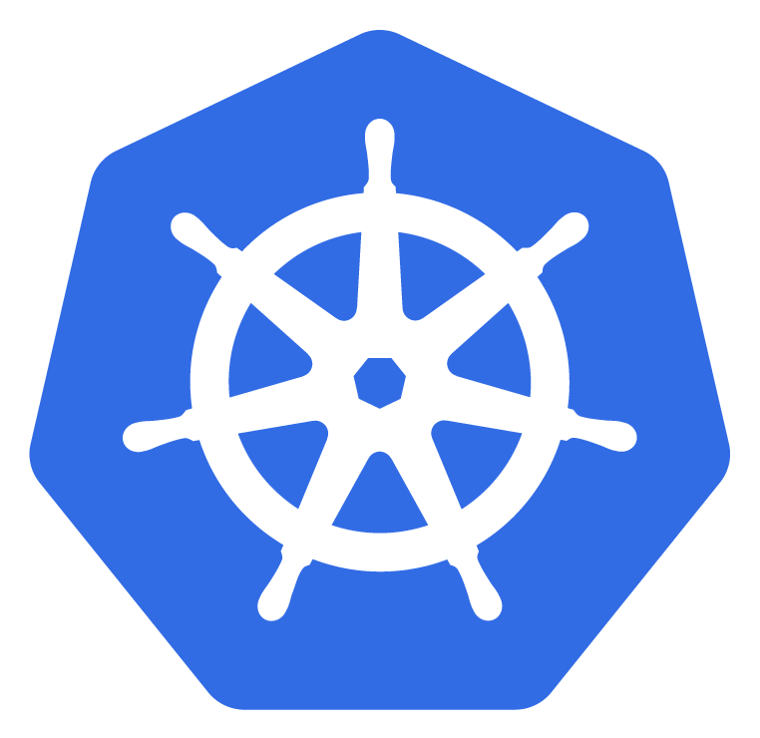
RESOURCE MANAGEMENT -
What it’s all about We can optionally specify how much CPU and memory (RAM) each Container needs. When Containers have resource requests specified, the scheduler can make better decisions about which nodes to place Pods on. And when Containers have their limits specified, contention for resources on a node can be handled in a specified manner. For each resource, containers can specify a resource request and limit

Slide 40
RESOURCE MANAGEMENT -
Each Container of a Pod can specify one or more of the following:
spec.containers[].resources.limits.cpu
spec.containers[].resources.limits.memory
spec.containers[].resources.limits.hugepages-<size>
spec.containers[].resources.requests.cpu
spec.containers[].resources.requests.memory
spec.containers[].resources.requests.hugepages-<size> CPU and memory are each a resource type. A resource type has a base unit. CPU is specified in units of cores, and memory is specified in units of bytes. NODE on Kubernetes => v1.14, we can specify huge page resources. Huge pages are a Linux-specific feature where the node kernel allocates blocks of memory that are much larger than the default page size (For DB for example).

Slide 41
RESOURCE MANAGEMENT -
CPU Limits and requests for CPU resources are measured in cpu units. One cpu, in Kubernetes, is equivalent to:
1 AWS vCPU
1 GCP Core
1 Azure vCore
1 IBM vCPU
1 Hyperthread on a bare-metal Intel processor with Hyperthreading enabled
We request for a cpu by setting spec.containers[].resources.requests.cpu = 1000m which means “1k millicores” single core (as seen above)

Slide 42
RESOURCE MANAGEMENT -
RAM Limits and requests for memory are measured in bytes An example - 129M or 4096K.

Slide 43
RESOURCE MANAGEMENT -
POD Request / Limit Example
apiVersion: v1
kind: Pod
metadata:
name: frontend
spec:
containers:
- name: db
…..
resources:
requests:
memory: "64Mi"
cpu: "250m"
limits:
memory: "128Mi"
cpu: "500m"
Request:
The pod on the left has one container in it that request from K8S Scheduler:
for 64Mi RAM (Approx 67.1MB) and 250m (0.25 Millicores).
** 250m I.E 250 / 1000 (Single core) = 0.25 of a single Core
**Mi = Mebibytes -> 1Mib = 1.048576 MB
Limit
While the Request is the amount of RAM and CPU the POD request to have from the get go… ‘Limits’ makes sure the pod wont overcommit.

Slide 44
RESOURCE MANAGEMENT -
There are 3 Classes of QOS in K8s for running PODS
https://kubernetes.io/docs/tasks/configure-pod-container/quality-service-pod/

Slide 45
RESOURCE MANAGEMENT -
NOTES - CPU
Pods will not be killed if CPU guarantees cannot be met (for example if system tasks or daemons take up lots of CPU), they will be temporarily throttled.

Slide 46
- K8S REPLICASETS -

Slide 47
K8S SPECS - REPLICASET
A ReplicaSet’s purpose is to maintain a stable set of Pods running at any given time. As such, it is often used to guarantee the availability of a specified number of identical Pods.
Meaning that once we set the number of Pods replicas we wish to start, K8S will be working on changing its state to the required number of Pods.
A ReplicaSet identifies new Pods to acquire by using its selector - see next slide.

Slide 48
K8S SPECS - REPLICASET
pods-replicaset.yaml
---
apiVersion: apps/v1
kind: ReplicaSet
metadata:
name: frontend
labels:
app: ui
tier: frontend
spec:
# here we select the number of pods we wish to start and the selector that tells our replica set which pods it needs # to manage
replicas: 3
selector: # Using the selector we tell our replicaset which pods to manage
matchLabels:
tier: frontend
template: # here we define our PODS Specs (k8s uses go template in the background)
metadata:
labels:
tier: frontend
spec:
containers:
- name: some-application
image: somerepo/someapp:2

Slide 49
K8S SPECS - REPLICA SET - QUESTION
Once we will learn about Deployments [Next slides] One will ask himself:
When should i use a ReplicaSet and when should i use Deployments as it appears they are doing the same thing of managing our Pods…??
The quick answer is: We should always use Deployments as it’s a higher-level concept that manages ReplicaSets and provides declarative updates to Pods along with a lot of other useful features.
Therefore, it is recommended using Deployments instead of directly using ReplicaSets.

Slide 50
- K8S DEPLOYMENTS -

Slide 51
K8S SPECS - DEPLOYMENTS
A Deployment object defines a Pod creation template and a desired replica count. The Deployment also uses label selector to identify the Pods that it manages, create or delete Pods as needed to meet the replica count configured in it’s spec. Deployments are also used to manage safely rolling out changes to our running Pods.
Deployment spec example in the next slide ->

Slide 52
K8S SPECS - DEPLOYMENT
nginx-deployment.yaml
--------------------------
apiVersion: apps/v1
kind: Deployment
metadata:
name: nginx-deployment
spec:
selector:
matchLabels:
app: nginx
replicas: 2 # tells deployment to run 2 pods matching the template using the ReplicaSet
template: # create pods using pod definition in this template
metadata:
# unlike pod-nginx.yaml, the name is not included in the meta data as a unique name is
# generated from the deployment name
labels:
app: nginx
spec:
containers:
- name: nginx
image: nginx:1.7.9
ports:
- containerPort: 80

Slide 53
- K8S DEPLOYMENT HANDSON -

Slide 54
K8S SPECS - DEPLOYMENTS
In the next example we will create a new deployment base on the following yaml
nginx-deployment.yaml ----------------------------
apiVersion: apps/v1
kind: Deployment
metadata:
name: nginx-deployment-test
spec:
selector:
matchLabels:
app: nginx
replicas: 2
template:
metadata:
labels:
app: nginx
spec:
containers:
- name: nginx
image: nginx:mainline-alpine
ports:
- containerPort: 80

Slide 55
K8S SPECS - DEPLOYMENTS
Create the file in your remote master server and then create the deploy
kubectl apply -f nginx-deployment.yaml --record
# Get deployment
kubectl get deployment # List the pods created by the Deployment
kubectl get pods -l app=nginx -o wide # Describe the deployment we created
kubectl describe deployment/nginx-deployment

Slide 56
K8S SPECS - DEPLOYMENTS
Lets upgrade our current deployment. When we change something in our deployment spec we can rerun it (deploy the change) using:
kubectl apply
# Change the nginx image tag version from: nginx:mainline-alpine to - nginx:latest
# Save the file and run kubectl apply -f [filename] --record
# Once deployed please run the following
# Get deployment
kubectl get deployment
# Get replicasets
kubectl get replicasets (See that now you got two replicasets)
# See rollout status of the deployment
kubectl rollout status deployment/nginx-deployment
# See rollout versions
kubectl rollout history deployment/nginx-deployment
# Rollback to specific revision
kubectl rollout undo deployment/nginx-deployment --to-revision=2

Slide 57
K8S SPECS - SCALING DEPLOYMENTS
Scale deployments
using the yaml file scale to 4
# Please DO NOT delete objects

Slide 58
- K8S SERVICES -

Slide 59
K8S SPECS - SERVICES
While each Pod gets its own IP address, even those IP addresses cannot be relied upon to be stable over time. That alone will lead to a huge problem: if some set of Pods (let’s call them backends) provides functionality to other Pods (let’s call them frontends) inside the Kubernetes cluster, how do those frontends find out and keep track of which backends are in that set?
To solve that K8S introduced - SERVICES

Slide 60
K8S SPECS - SERVICES
K8S Service is an abstraction which defines a logical set of Pods and a policy by which to access them - sometimes called a micro-service. The set of Pods targeted by a Service is (usually - also) determined by a Label Selector
For Kubernetes-native applications, Kubernetes offers a simple Endpoints API that is updated whenever the set of Pods in a Service changes. For non-native applications, Kubernetes offers a virtual-IP-based bridge to Services which redirects to the backend Pods.

Slide 61
K8S SPECS - DEFINING A SERVICE
---
kind: Service # Create new service
apiVersion: v1
metadata:
name: my-service # Name of the service (DNS - RFC 2929)
spec:
selector:
app: MyApp # Run on any pod with label - app:myapp
ports: # Map incoming port to target port
- name: thistoweb # Setting multiple ports listen
protocol: TCP
port: 80
targetPort: 9376
- name: management
protocol: UDP
port: 7372
targetPort: 7372
---

Slide 62
K8S SPECS - SERVICES
Good To Know - Every node in a Kubernetes cluster runs a kube-proxy. kube-proxy is responsible for implementing a form of virtual IP for Services of type other than ExternalName. In Kubernetes v1.0, Services are a “layer 4” (TCP/UDP over IP) construct, the proxy was purely in userspace. In Kubernetes v1.1, the Ingress API was added to represent “layer 7”(HTTP) services, iptables proxy was added too, and become the default operating mode since Kubernetes v1.2. In Kubernetes v1.8.0-beta.0, ipvs proxy was added.

Slide 63
- K8S SERVICES HANDSON -

Slide 64
K8S SPECS - SERVICES
In the following Handson workshop you will create a new deployment spec and expose it using LoadBalancer service spec. everything that you need to know is in the previous slides
Create a new deployment spec with
IMAGE: yanivomc/spring-music:latest
Number of Replicas : 2
Container Port: 8080
Create a new service spec
Make sure your selector match the labels of the deployed pods…
Source Port: 80
Target Port: 8080
Type: LoadBalancer ( Google it where to add type=LoadBalancer…)
Once deployed you should be able to see two pods in the service endpoints and browse our deployed application

Slide 65
K8S SPECS - SERVICES - canary release
Create a new deployment spec with
IMAGE: supergiantkir/animals:hare
Number of Replicas : 2
Container Port: 80
Create a new deployment spec with
IMAGE: supergiantkir/animals:bear
Number of Replicas : 2
Container Port: 80
Create a new service spec
Make sure your selector match the labels of the both deployments
Source Port: 80
Target Port: 80
Type: LoadBalancer
Once deployed you should be able to see 4 pods in the service endpoints and browse our deployed application

Slide 66
K8S SPECS - SERVICES - canary release
Using the scaling capability change the number of pods to 1 for the first deployment and to 3 for the second deployment
now refresh you web page using ctrl+f5 and see how both a HARE and a BEAR appear in your browser

Slide 67
- HELM -

Slide 68
Helm is a package manager for Kubernetes applications. In this tutorial, we'll understand the basics of Helm and how they form a powerful tool for working with Kubernetes resources.

Slide 69
Module Agenda: K8S HELM
WHAT IS HELM
WHAT ARE CHARTS
INSTALLING HELM
HANDSON - INGRESS
WRITING OUR OWN CHARTS

Slide 70

K8S HELM
Helm helps you manage Kubernetes applications — Helm Charts helps you define, install, and upgrade even the most complex Kubernetes application. Charts are easy to create, version, share, and publish — so start using Helm and stop the copy-and-paste madness.

Slide 71
HELM Architecture
Helm has a simple architecture, *HELM v2 Comprised of a client and an in-cluster server:
Tiller Server: Helm manages Kubernetes application through a component called Tiller Server installed within a Kubernetes cluster. Tiller interacts with the Kubernetes API server to install, upgrade, query and remove Kubernetes resources.
Helm Client: Helm provides a command-line interface for users to work with Helm Charts. Helm Client is responsible for interacting with the Tiller Server to perform various operations like install, upgrade and rollback charts and can be installed locally on your laptop and communicate with the Tiller on your cluster

Slide 72
What are helm charts?
Helm uses a packaging format called charts. A chart is a collection of files that describe a related set of Kubernetes resources. A single chart might be used to deploy something simple, like a memcached pod, or something complex, like a full web app stack with HTTP servers, databases, caches, and so on.
Charts are created as files laid out in a particular directory tree, then they can be packaged into versioned archives to be deployed. The following explains the chart format, and provides basic guidance for building charts with Helm.

Slide 73
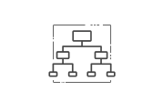


K8S HELM
So Why you’re going to love Helm
Manage Complexity
Easy Updates
Simple Sharing
Charts describe even the most complex apps; provide repeatable application installation, and serve as a single point of authority.
Take the pain out of updates with in-place upgrades and custom hooks.
Charts are easy to version, share, and host on public or private servers.

Slide 74
- INSTALLING HELM -

Slide 75
K8S HELM - INSTALLING
Linux: Install Snapd - Linux app store
sudo apt update
sudo apt install snapd # IF ASKED PLEASE ENTER CAPITAL “Y”!
sudo snap install core # without this snap wont work -
sudo snap install --channel=2.16 helm --classic
Once completed the above step:
$ kubectl --namespace kube-system create serviceaccount tiller
$ kubectl create clusterrolebinding tiller --clusterrole cluster-admin --serviceaccount=kube-system:tiller
$ helm init --stable-repo-url https://charts.helm.sh/stable --service-account tiller --wait
$ …. Tiller (the Helm server-side component) has been installed into your Kubernetes Cluster.
* Helm will be installed and connected to the K8S Cluster our kubectl is configure to work with under a namespace (cluster inside our cluster - namespace )

Slide 76
K8S HELM - INSTALLING
STOP POST STEP III
Step I
kubectl get pods --namespace kube-system | grep tiller
$ tiller-deploy-f7bd48bf-bj6h8 1/1 Running 0 3m
Step II
helm version # will output both server and client version - both version need to match
$ Client: &version.Version{SemVer…….
$ Server: &version.Version{SemVer:...
Step III
$ helm repo update
$ helm search # to see available online packages

Slide 77
Running an example CHART
Search Helm repo for mysql
$ helm search mysql
Install MYSQL
$ helm install --name mysql stable/mysql ** Once deployed - review the release information and deployment status provided on screen
View what was released by helm
$ helm ls
Uninstall a release
$ helm delete [release name] --purge
View online Helm repo
https://hub.kubeapps.com/
*** Whenever we install a chart, a new release is created. So one chart can be installed multiple times into the same cluster. And each can be independently managed and upgraded

Slide 78
- DEVELOPING OUR FIRST CHART -

Slide 79
K8S HELM - INSTALLING
Building our first chart
Now we are ready to develop our first Helm Chart with templates and values.
Step I: Creating a new Chart
$ helm create spring-music **Please note that the name of the chart provided here will be the name of the directory where the chart is created and stored
Let’s review the content of the folder and files created for us by “helm create’
ls -ltrh spring-music/ ** OPTIONAL files need to be created manually
Chart.yaml # A YAML file containing information about the chart ( to be used by the template engine)
LICENSE # OPTIONAL: A plain text file containing the license for the chart
README.md # OPTIONAL: A human-readable README file
requirements.yaml # OPTIONAL: A YAML file listing dependencies for the chart
values.yaml # The default configuration values for this chart
charts/ # A directory containing any charts upon which this chart depends.
templates/ # A directory of templates that, when combined with values,
# will generate valid Kubernetes manifest files.
templates/NOTES.txt # OPTIONAL: A plain text file containing short usage notes

Slide 80
If we check the inside of the template directory, we'll notice that few templates for common Kubernetes resources have already been created for us:
spring-music /
templates /
deployment.yaml # Basic manifest for creating a deployment
service.yaml # Basic manifest for creating a service
ingress.yaml # Basic manifest for creating an ingress _helpers.tpl # this is file is a where we put “template helpers” that we can re-use throughout the chart!
NOTES.txt # The “help text” for your chart. This will be displayed to your users when they run helm install
We may need some of these in our application and other we'll have to create ourselves as templates to be reused.
But for this workshop we will create a package (chart) for deploying our spring music application.
For this we will need a _helper , Deployment , Service and a NOTEST.txt files

Slide 81
To perfectly understand what does what and how to really build our first helm we will DELETE everything under template/* folder and create our own files and _helpers
mkdir helm
cd helm
helm create spring-music
rm -rf spring-music/templates/*
rm -rf spring-music/values.yaml
** Do note that When we write production grade charts, having basic versions of these charts can be really useful. So in our day-to-day chart authoring, we probably won’t want to remove them but reuse them

Slide 82
- WRITING OUR FIRST CHART -

Slide 83
Preface
Our spring music application will run 2 frontend containers and a configmap where we will store some configuration information for our application to use.
Using HELM we will create , Deploy and maintain our SPRING-MUSIC application lifecycle

Slide 84
ConfigMap: ConfigMap is simply a container for storing configuration data. Other things, like pods, can access the data in a ConfigMap.
vim spring-music/templates/configmap.yaml
apiVersion: v1
kind: ConfigMap
metadata:
name: mychart-configmap
data:
dbname: "db-mysql"
dbtable: "music"
eat: "jam"
1. The YAML on the left is a bare-bones ConfigMap, with only minimal necessary fields. In virtue of the fact that this file is in the templates/ directory, it will still be sent through the template engine and to K8S as is.
2. Once we review and validate this one, we will update and create a more dynamic template ConfigMap file.
** TIP: Template names do not follow a rigid naming pattern. However, we recommend using the suffix .yaml for YAML files and .tpl for helpers.

Slide 85
ConfigMap: Lets test and deploy our first chart
helm install ./spring-music
NAME: dusty-turkey
LAST DEPLOYED: Wed Sep 18 19:14:21 2019
NAMESPACE: default
STATUS: DEPLOYED
RESOURCES:
==> v1/ConfigMap
NAME DATA AGE
mychart-configmap 3 0s
** NAME: is dynamically created and can be overwritten by adding the attribute --name
In the output on the left, we can see that our ConfigMap was created and deployed.
helm get manifest dusty-turkey
---
# Source: spring-music/templates/configmaps.yaml
apiVersion: v1
kind: ConfigMap
metadata:
name: mychart-configmap
data:
dbname: "db-mysql"
dbtable: "music
Using Helm, we can retrieve the release and see the actual template that was uploaded to achieve this.

Slide 86
ConfigMap: Adding Template call to our file
helm ls # getting package name
helm delete PACKAGENAME --purge
First lets delete our release
apiVersion: v1
kind: ConfigMap
metadata:
name: {{ .Release.Name }}-configmap
data:
dbname: "db-mysql"
dbtable: "music"
1. A template directive is enclosed in {{ and }} blocks.
The template directive {{ .Release.Name }} injects the dynamic or manual release name into the template. The values that are passed into a template can be thought location in namespaced objects, where a dot (.) separates each namespaced element.
*** TIP: The name: field is limited to 63 characters because of limitations to the DNS system. For that reason, release names are limited to 53 characters.

Slide 87
NOTE: Example for Release - Built in object
Release.Name: The release name
Release.Time: The time of the release
Release.Namespace: The namespace to be released into (if the manifest doesn’t override)
Release.Service: The name of the releasing service (always Tiller).
Release.Revision: The revision number of this release. It begins at 1 and is incremented for each helm upgrade.
Release.IsUpgrade: This is set to true if the current operation is an upgrade or rollback.
Release.IsInstall: This is set to true if the current operation is an install.
The Release object describes the release itself. It has several objects inside of it as we can see on the left.
More Built In objects can be viewed here

Slide 88
ConfigMap: Deploy and view the change (and delete)
helm install ./spring-music
NAME: joyous-butterfly
LAST DEPLOYED: Wed Sep 18 19:34:51 2019
NAMESPACE: default
STATUS: DEPLOYED
RESOURCES:
==> v1/ConfigMap
NAME DATA AGE
joyous-butterfly-configmap 3 0s
Using dry-run when we want to test the template rendering without actual deploy
helm install ./spring-music --debug --dry-run
** NOTE: Using --dry-run will make it easier to test your code, but it won’t ensure that Kubernetes itself will accept the templates you generate. It’s best not to assume that your chart will install just because --dry-run works

Slide 89
Values Files: One of the built-in objects is Values. This object provides access to values passed into the chart. Its contents come from four possible sources and by this order:
The values.yaml file in the chart
If this is a subchart, the values.yaml file of a parent chart
A values file is passed into helm install or helm upgrade with the -f flag (“helm install -f myvals.yaml ./mychart” where myvals.yaml is a custom file we create outside our Chart)
Individual parameters passed with --set (such as helm install --set foo=bar ./mychart)
We start by deleting our values.yaml file and than we customize it as we required
rm -rf spring-music/values.yaml

Slide 90
Values Files: Custom / Reusable values
vim spring-music/values.yaml
dbname: "db_mysql"
dbtable: "music"
image: "yanivomc/spring-music"
tag: "latest"
Edit our ConfigMap file
vim spring-music/templates/configmaps.yaml
apiVersion: v1
kind: ConfigMap
metadata:
name: {{ .Release.Name }}-configmap
data:
dbname: {{ .Values.dbname }}
dbtable: {{ .Values.dbtable }}
dry-run and validate change and also test --set dbname=oracle
helm install ./spring-music --debug --dry-run
data:
dbname: "db-mysql" --->>> Dynamically created
dbtable: "music" --->>> Dynamically created

Slide 91
Values Files: Custom / Reusable values
Values can contain more structure content as followed:
vim spring-music/values.yaml
database:
dbname: db_mysql
dbtable: music
pods:
image: yanivomc/spring-music
tag: latest
Update our ConfigMap file and dry run it
vim spring-music/templates/configmaps.yaml
apiVersion: v1
kind: ConfigMap
metadata:
name: {{ .Release.Name }}-configmap
data:
dbname: {{ .Values.database.dbname }}
dbtable: {{ .Values.database.dbtable }}

Slide 92
- Template Functions and Pipelines -

Slide 93
Template Functions and Pipelines: There are many cases where we wish to manipulate the default or passed values (ex. Quote, Upper , Trim (if values is longer than x characters)...)
Helm has over 60 available functions for us to use inside our templates. Those functions are based on the GO Template language itself.
Functions can be viewed here
HELM allows us to use PIPELINES ( value | function ) same as we do in linux for multiple functions
somekey: {{ .Values.tree.somevalue | upper | quote }}

Slide 94
Lab: Functions
On our Default values file add the following structured values:
Create new CHART and add the following values: (* Don't forget to delete the other template files!)
food
smoke: cigars
eat: Peanut Butter and Jelly sandwich
update configmap and propagated the above values in our config map file.
make the “smoke” value will be outputted as CAPITAL
make sure the “eat” value is truncated to 13 characters , quoted & Uppercase
Once complete please send
helm install --debug --dry-run ./[chartname]/ to my chat (private)
Click here for all function

Slide 95
LAB Solution:
vim spring-music/values.yaml
database:
dbname: db_mysql
dbtable: music
pods:
image: yanivomc/spring-music
tag: latest
food:
drink: beer eat: Peanut Butter and Jelly sandwich
Update our ConfigMap file and dry run it
vim spring-music/templates/configmaps.yaml
apiVersion: v1
kind: ConfigMap
metadata:
name: {{ .Release.Name }}-configmap
data:
dbname: {{ .Values.database.dbname }}
dbtable: {{ .Values.database.dbtable }}
drink: {{ .Values.food.drink | upper }}
eat: {{ .Values.food.eat | upper | trunc 13 | quote}}

Slide 96
- Template Helper files “_” -

Slide 97
Template helper files: Most files in templates/ are treated as if they contain Kubernetes manifests with one exception - NOTES.txt [tbd]
But files whose name begins with an underscore (_) are assumed to not have a manifest inside. These files are not rendered to Kubernetes object definitions, but are available everywhere within other chart templates for use. These files are used to store partials and helpers. In fact, when we first created mychart, we saw a file called _helpers.tpl. That file is the default location for template partials
Inside those files we can use an action called define. With it we can create a named template INSIDE of a template file and than pull inject it and it’s content to a template file we’ve built.
Its syntax goes like this
{{ define "my.name" }}
# body of template here
{{ end }}

Slide 98
Template helper files:
vim spring-music/templates/_helpers.tpl
{{/* This is a comment - Generate basic labels */}}
{{- define "spring.labels" }}
generator: by-helm
date: {{ now | htmlDate }}
name: {{ .Release.Name }}
dname: {{ .Values.database.dbname }}
{{- end }}
Edit our ConfigMap file and implement the labels inside the metadata and dry run it
vim spring-music/templates/configmap.yaml
apiVersion: v1
kind: ConfigMap
metadata:
labels:
{{- include "spring.labels" . | nindent 4 }}
data:
dbname: {{ .Values.dbname }}
dbtable: {{ .Values.dbtable }}
** NOTES: the nindent will make sure the generated content will keep the right indent
Check out flow control using Helpers: https://helm.sh/docs/chart_template_guide/control_structures/

Slide 99
- DEPLOYMENT AND SERVICE -

Slide 100
Deployment and Service: With what we’ve learned up until know, we can create a deployment file and a service file.
LAB:
Create a deployment file and grab / create the following from and in our Values and _Helper file
Deployment name: Chart name + Version (Tip: “{{ .Chart.Name }}-{{ .Chart.Version }}” )
Image and Tag name
Labels and selectors as helper
generator: helm
app-name: the chart-name
date: creation date
version: the chart-version
Replica number
** NOTE: Deployment baseline yaml file in the next slide and solutions right after

Slide 101
Deployment.yaml Template base
vim spring-music/templates/deployments.yaml
apiVersion: apps/v1
kind: Deployment
metadata:
name: {{ RELEASE NAME }}-deployment
labels:
[_helper]
spec:
replicas: [dynamic] (if PROD = TRUE REPLICA=2 ELSE 1)
selector:
matchLabels:
[_helper]
template:
metadata:
labels:
[_helper]
spec:
containers:
- name: [dynamic]
image: yanivomc/spring-music:latest (make it dynamic)
imagePullPolicy: IfNotPresent
ports:
- name: http
containerPort: [dynamic]
protocol: TCP
vim spring-music/templates/services.yaml
apiVersion: v1
kind: Service
metadata:
name: {{ RELEASE NAME }}-svc
labels:
[_helper]
spec:
type: [dynamic] >>>> ((((IF CLOUD=TRUE > LoadBalancer ELSE NODEPORT) )))
ports:
- name: http
protocol: TCP
port: [dynamic] ((((80)))))
targetPort: [dynamic] ((((((8080)))))
selector:
[_helper)

Slide 102
- INGRESS CONTROLLERS -

Slide 103
Module Agenda: K8S INGRESS
WHAT ARE K8S ANNOTATIONS
INGRESS
TRAEFIC

Slide 104
CODE SOLUTION FOR THE INGRESS PART
https://github.com/yanivomc/seminars/tree/master/K8S/ingress

Slide 105
- ANNOTATIONS -

Slide 106
ANNOTATIONS
If we need to point Kubernetes to a group of resources, labels are the way to go.
But if we want to annotate our setup with data which will help tools, but not Kubernetes itself, we will use annotations.
Example of annotations for alb ingress controller
https://kubernetes-sigs.github.io/aws-alb-ingress-controller/guide/ingress/annotation/

Slide 107

- TRAEFIC -
Code and Solutions for this part can be found here: https://github.com/yanivomc/seminars/tree/master/K8S/ingress/traeifk

Slide 108
About Traefik
Traefik listens to our service registry/orchestrator (K8S in our case) API and instantly generates the routes so your microservices are connected to the outside world -- without further intervention from your part.
Read more: https://docs.traefik.io/

Slide 109
Deploying Traefik
We are going to use a custom values for this helm package so first we download it: 1. wget https://raw.githubusercontent.com/yanivomc/seminars/master/K8S/ingress/traeifk/values.yaml 2. helm install stable/traefik --name traefic-ingress --namespace kube-system --values values.yaml ---- ……
Validate installation 1. Watch LOAD BALANCER Creation - Once 'EXTERNAL-IP' is no longer '<pending>' and changed to CNAME of the ALB kubectl get svc traefic-blog-traefik --namespace kube-system -w # NOTE that -w will run the command and wait for creation of service NAME TYPE CLUSTER-IP EXTERNAL-IP PORT(S) traefic-blog-traefik LoadBalancer 100.65.191.239 a001f8b9dc6a3... 80:30049/TCP,443:31671/TCP 2. get the ALB CNAME by running: ALBIP=`kubectl describe svc traefic-ingress-traefik --namespace kube-system | grep Ingress | awk '{print $3}'`
3. Get ONE of the ALB IP by running: sudo docker run tutum/dnsutils dig +short $ALBIP Add the ip to your hosts file so we will be able to reach to our traefic dashboard (in linux: /etc/hosts - windows: C:\Windows\System32\Drivers\etc\hosts) as followed <LB IP> traefik.example.com bear.jb moose.jb hare.jb animals.jb canary.jb
4. Open a new TAB and Browse http://traefik.example.com # NOTE that you can’t browse the ALB cname and reach to the Dashboard without a proper DOMAIN as we know use ALB (Layer 7) and not the ELB (Layer 4)

Slide 110
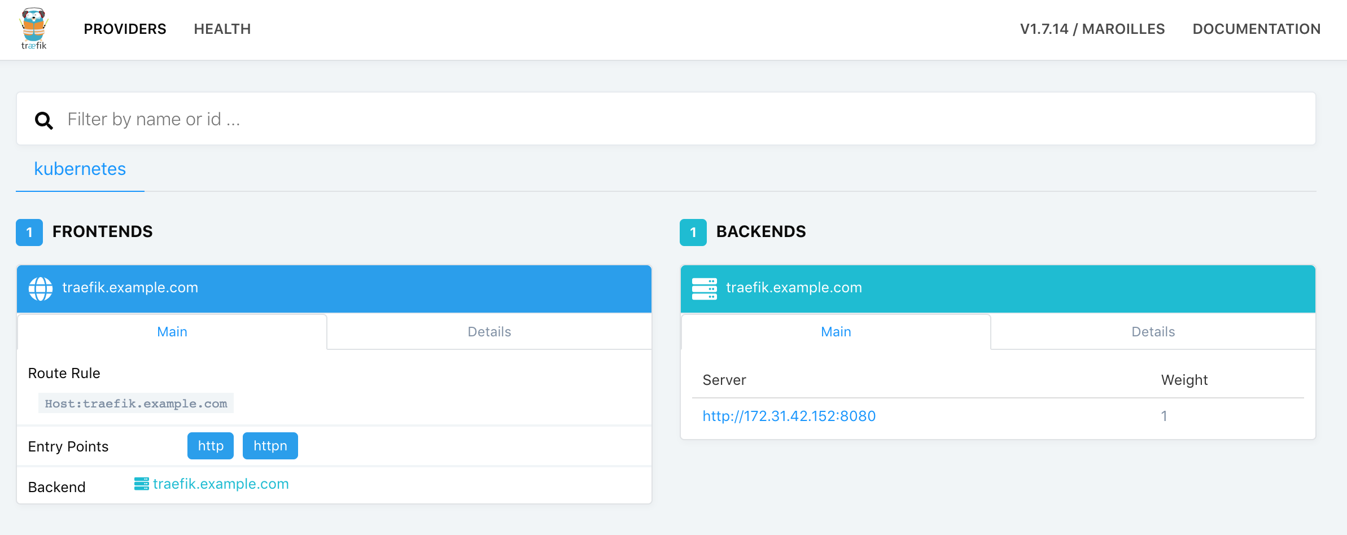
IF Deployed correctly your browser will show the following

Slide 111
NAME BASED ROUTING
We will use our newly Ingress Controller to set up name-based (domain) routing for a list of frontends. We will create three Deployments with simple single-page websites displaying images of animals: bear, hare, and moose.

Slide 112
- TRAEFIC LAB -
Code and Solutions for this part can be found here: https://github.com/yanivomc/seminars/tree/master/K8S/ingress/traeifk/application/namebase-routing

Slide 113
LAB - INGRESS 01 (Solutions here file name 01-animals-deployments.yaml)
Create the following YAML SPEC
3 Deployments specs (all in the same yaml file)
Metadata name: bear , moose , hare
Labels: app=animals , animal=[bear/moose/hare]
Image: supergiantkir/animals:moose , supergiantkir/animals:bear , supergiantkir/animals:hare
Replica = 2
Metadata for containers add - version: v0.0.1
Container port = 80
Solutions here file name 02-animals-services.yaml
3 Services specs (all in the same yaml file)
Metadata name: bear , moose , hare
Targetport = 80
Port=80
Selector: TIP Note that we got two labels per pod….
CLUSRTERIP

Slide 114
SKIP LAB - INGRESS 01
Create the following YAML SPEC
For the 3rd Service we are going to use something called circuitbreaker - A circuit breaker is the Traefik feature that prevents high loads on the failing server. In this example, we prevent the high loads on servers with the NetworkErrorRatio greater than 50%. When this condition matches, CB enters a Tripped state where it responds with predefined HTTP status code or redirects to another frontend.
To configure this special option we will use - Annotations. In our 3rd service for Hare please use the following:
metadata:
name: hare
annotations:
traefik.backend.circuitbreaker: "NetworkErrorRatio() > 0.5"

Slide 115
LAB - INGRESS 01
Create the following YAML SPEC
Save your deployments and services files and run them as followed: 1. kubectl apply -f 01-animals-deployments.yaml
2. kubectl apply -f 02-animals-services.yaml We should expect to see 3 Deployments with 3*2 pods (2 pods per deployment) and 3 services (ClusterIP).
$> kubectl get pods NAME READY STATUS RESTARTS AGE bear-6cdcfd7849-gmj5h 1/1 Running 0 15s bear-6cdcfd7849-vs7xw 1/1 Running 0 15s hare-594fbb9bc7-xpwqd 1/1 Running 0 15s hare-594fbb9bc7-z5srm 1/1 Running 0 15s moose-6999c6f85d-5rk64 1/1 Running 0 15s moose-6999c6f85d-bjr4g 1/1 Running 0 15s $> kubectl get svc # svc is a short for services NAME TYPE CLUSTER-IP EXTERNAL-IP PORT(S) AGE moose ClusterIP 172.31.28.206 <none> 80/TCP 2m27s hare ClusterIP 172.31.20.13 <none> 80/TCP 2m57s bear ClusterIP 172.31.16.34 <none> 80/TCP 3m12s Make sure there are no Errors and continue to part 2 of this lab - Creating the ingress rules

Slide 116
LAB - INGRESS 01 Part 2
Creating the ingress rule
Now, lets create Ingress with three frontend-backend pairs for each Deployment:
bear.jb , moose.jb , and hare.jb will be our frontends pointing to corresponding backend Services.
On the next slide see the start of the ingress rule and YOU will have to add the other two missing hosts (bear and moose)

Slide 117
LAB - INGRESS 01 Part 2 (Solution here)
Creating the ingress rule - once completed you should run the file using “kubectl apply -f [filename] and then validate it’s working (next slide)
apiVersion: extensions/v1beta1
kind: Ingress
metadata:
name: animals
annotations:
kubernetes.io/ingress.class: traefik
spec:
rules:
- host: hare.jb
http:
paths:
- path: /
backend:
serviceName: hare
servicePort: http

Slide 118
LAB - INGRESS 01 Part 3 Verify deployment
Run the following commands to verify
Verify that everything was deployed by running
kubectl get all -l "app=animals"
3 deployments , 2 pods per deploy
kubectl get svc
3 services - 1 per deploy
kubectl get/describe ingress/animals # this will show our ingress controller we just created
1 ingress with the name “Animals” and 3 hosts hare.jb,bear.jb,moose.jb
Update your local machine host file to the following
On the same IP we set traefic.example.com add:
IP FOR EXAMPLE!. 252.84.32.22 bear.jb moose.jb hare.jb
Browse each of the hosts and see if they are working
http://hare.jb
http://bear.jb
http://moose.jb
Browse your traefic dashboard (http://traefik.example.com) and view the following (next slide)

Slide 119
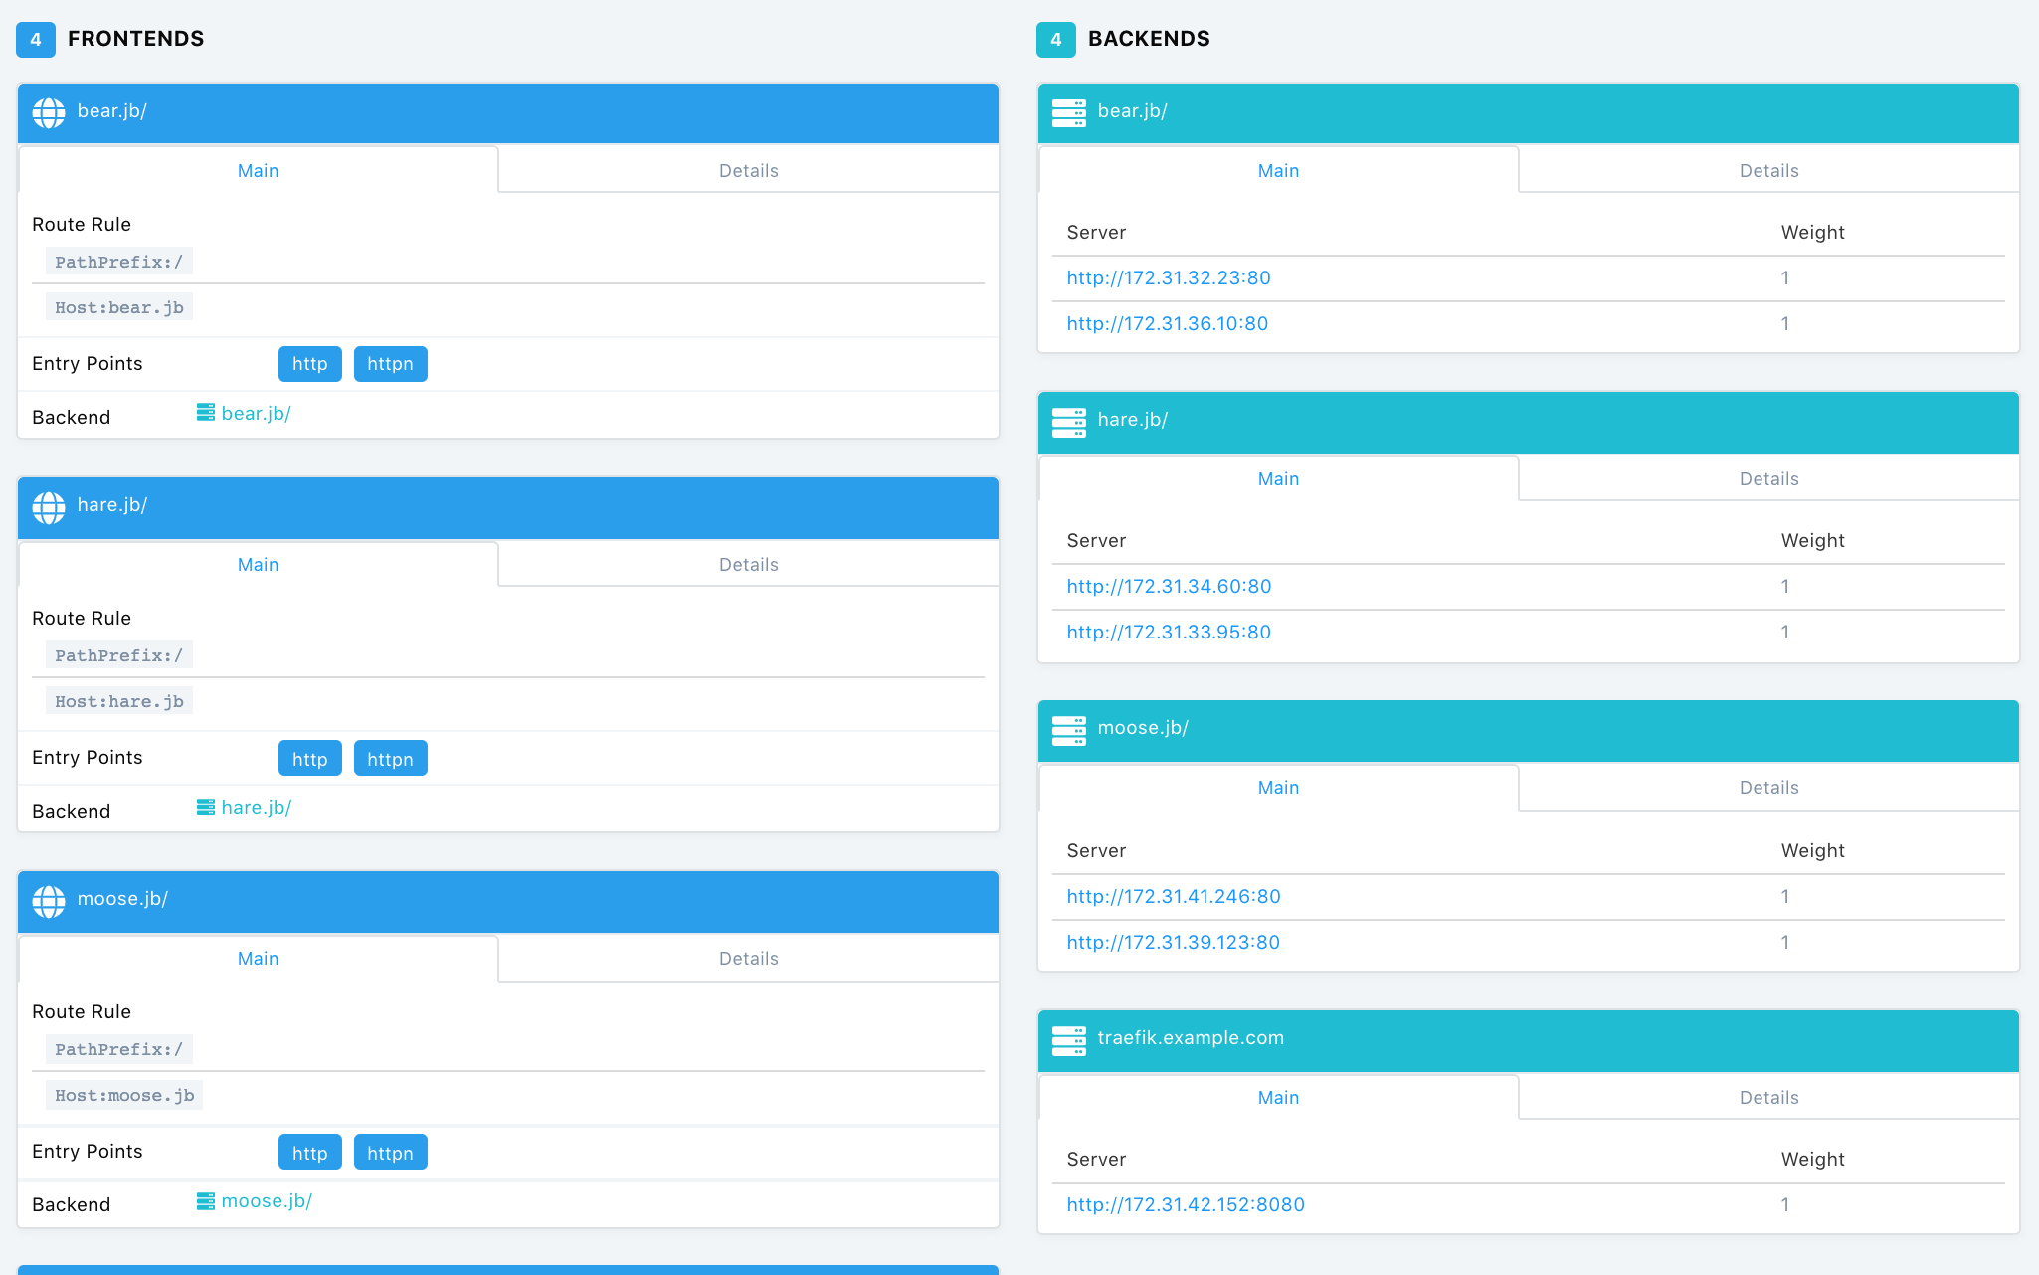
LAB - INGRESS 01 Part 3 Verify deployment

Slide 120
LAB - INGRESS 01 Part 3
Now we will create an ingress rule with single Host and multiple path
In this setup we will create a single host ingress that has multiple paths. For example browsing http://something.exmple.com/bear , http://something.exmple.com/moose …
To this we will create a new ingress with the following (next slide)

Slide 121
LAB - INGRESS 01 Part 3 (Solution here)
Creating an ingress rule with single Host and multiple path
apiVersion: extensions/v1beta1
kind: Ingress
metadata:
name: animals
annotations:
kubernetes.io/ingress.class: traefik
traefik.frontend.rule.type: PathPrefixStrip # click here for more options
spec:
rules:
- host: animals.jb
http:
paths:
- path: /bear
backend:
serviceName: bear
servicePort: http
…… Add the others...

Slide 122
LAB - INGRESS 01 Part 3
Creating an ingress rule with single Host and multiple path
apiVersion: extensions/v1beta1
kind: Ingress
metadata:
name: animals
annotations:
kubernetes.io/ingress.class: traefik
traefik.frontend.rule.type: PathPrefixStrip # click here for more options
### Note: We are configuring Traefik to strip the prefix from the Url path with the traefik.frontend.rule.type annotation. This way we can use the containers from the previous example without modification.
Now update your hosts file with animals.jb to point to the LB and tests http://animals.jb/bear/ and others ** dont forget the “/” at the end

Slide 123
LAB - INGRESS 01 Part 4 (FULL solution here)
Creating an ingress rule with split traffic (Canary release usage for example)
With Traefik, users can split Ingress traffic in a controlled manner between multiple deployments using service weights. This feature can be used for canary releases that should initially receive a small but ever-increasing fraction of traffic over time.
Let’s split the Traefik between two microservices using the following manifest (EXAMPLE next slide)

Slide 124
apiVersion: extensions/v1beta1
kind: Ingress
metadata:
annotations:
traefik.ingress.kubernetes.io/service-weights: |
bear-app: 80%
moose-app-canary: 20%
name: animals-app
spec:
rules:
- http:
paths:
- backend:
serviceName: bear-app # create new deploy and services with bears only
servicePort: 80
path: /
- backend:
serviceName: moose-app-canary # create new deploy with moose
servicePort: 80
path: /
LAB - INGRESS 01 Part 4
Creating an ingress rule with split traffic (Canary release usage for example)

Slide 125
Thank You!

